Slide 1
Netflix
2017 Stock Profile
July 10, 2018
By Tamara Moaze

Slide 2
Overview
In my new role as a data visualization developer at Yahoo finance, I have created a stock profile to assist the financial analysts using the publicly traded company’s data.
The data is for the the year 2017 and is visualized in a variety of plots.

Slide 3
List of Visualizations
Distribution of Netflix Stock prices
Netflix stock and Revenue for all four quarters in 2017
Earned versus Actual Earnings per share for 2017
Netflix Stock versus Dow Jones Stock for 2017

Slide 4
Understanding the Data

Slide 5
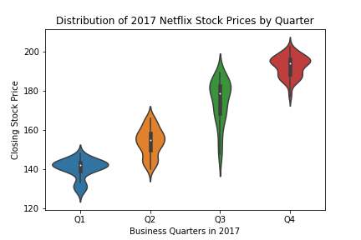
Netflix Stock Prices 2017
Analysis
The fourth quarter recorded the highest stock price for 2017.
Most stock prices fell between $140 to $190 during 2017
Notes:
The first impression is that the fourth quarter stock price is higher than the first quarter and also the stock price increases each quarter.
Most prices fell between $140 to $190 during the year
The lowest price is approximately $122.00 and the highest price approximately $210.00

Slide 6
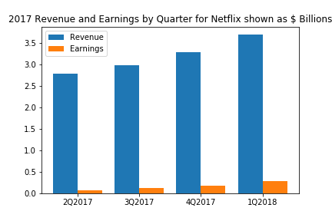
Netflix Stock and Revenue for all four quarters in 2017
Analysis
The fourth quarter revenue is the highest for 2017.
The second quarter has the lowest revenue figures.
Notes:
The first quarter revenue is the highest of 2017 and the second quarter has the lowest revenue figures.
Earnings follow revenue in terms of highest and lowest figures for the same quarters.
Earnings represent .04% of revenues

Slide 7
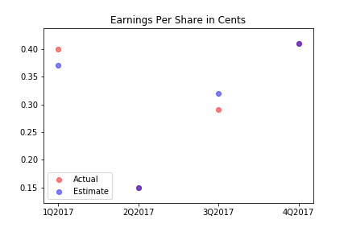
Netflix Earned versus Actual Earnings per Share for 2017
Analysis
The second and fourth quarter actual and estimate have the same values.

Slide 8
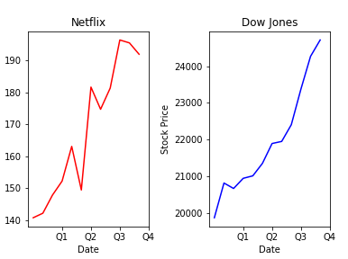
Netflix Stock versus Dow Jones Stock for 2017
Analysis
Netflix stock prices are more volatile than DowJones.
Notes:
Netflix experienced sharp increases and decreases whereas the Dow Jones Industrial Average trended upward going into the second quarter.
The Netflix stock price is more volatile.
The Dow Jones Industrial Average has the higher stock price.

Slide 9
End of Presentation

